Slide 1

Employee Retention
HR Analytics

Slide 2

Contents
Project Objective
Understanding Dataset
Implementation of KPI’s
Overview And Major Findings
Dashboard in Excel, Tableau, Power BI

Slide 3

Project Objective
This project is aimed at providing HR managers and business leaders a comprehensive way to analyze and monitor employee data, and make data-driven decisions related to employee retention, development, and recruitment.
This includes trendline and target line to help HR managers track progress toward reducing attrition.

Slide 4
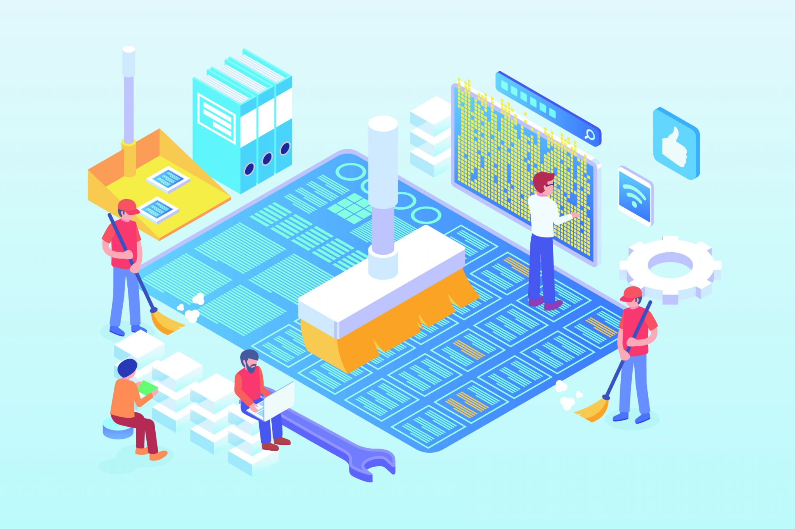
Understanding Dataset
Combine two different datasets in Excel (HR1 & HR2)
Remove Duplicates & Null values
Change the formatting of necessary columns.
Change Case - Lower/Upper/Proper.
Trim the unwanted spaces.
Find and Replace.
Conditional Formatting using power query.

Slide 5
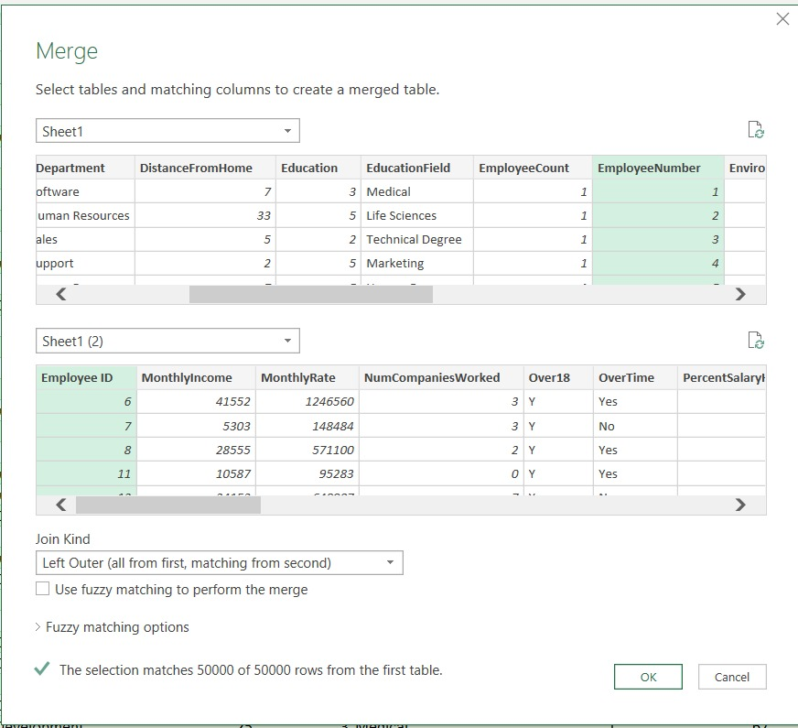
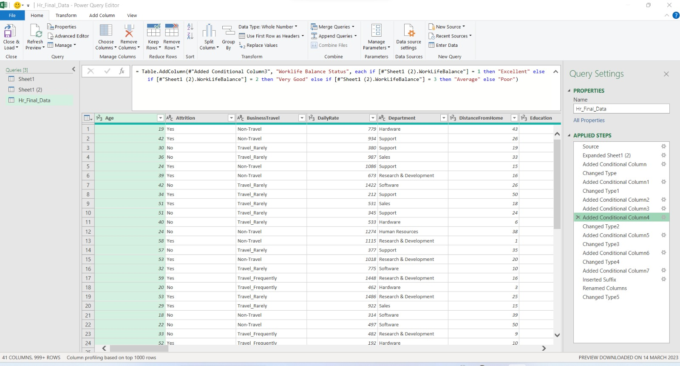
Merging two different datasets in Excel (HR1 & HR2)
Forming new columns as per KPI's requirements using Power Query.

Slide 6


Implementation of KPI's
Average Attrition rate for all Departments
Average Hourly rate of Male Research Scientist
Attrition rate Vs Monthly income stats
Average working years for each Department
Job Role Vs Work life balance
Attrition rate Vs Year since last promotion relation

Slide 7
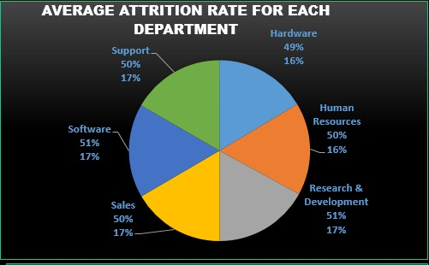
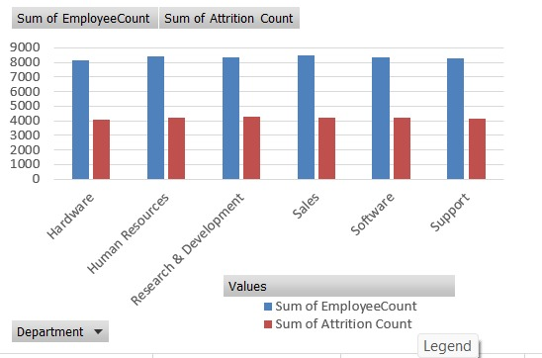
KPI 1: Average Attrition rate for all Departments
Insights :
Here, values are shown as percentage & count of total no of employees.
Majority of the employees are from the Software department and R&D department has the highest attrition rate of 51% with count of 4213 & 4260 employees.
Hardware department has lowest attrition rate of 49 % with the count of 4039 employees.

Slide 8
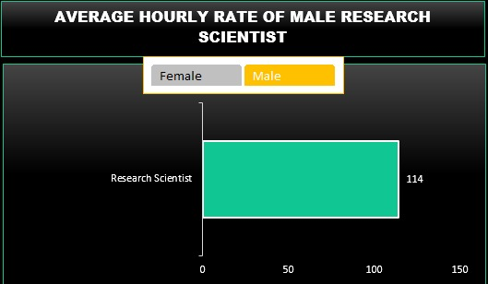
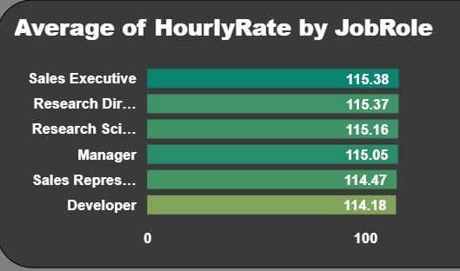
KPI 2: Average Hourly rate of Male Research Scientist
Insights :
Average Hourly rate of Male Research Scientist is 114 out of 115.16.
The highest average hourly rate is 115.38 of Sales Executive department while Developers has lowest average hourly rate of 114.18.

Slide 9
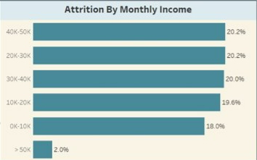
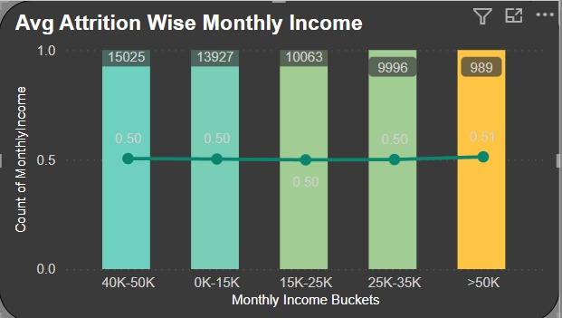
KPI 3: Attrition rate Vs Monthly income stats
Insights :
Here, values are shown as percentage & count of attrition vs monthly income.
It is observed that Maximum employee 15025 out of 50000 falls under the salary range of 40k - 50k and has highest attrition rate of 20.2%
The salary range of above 50k has the lowest attrition rate of 2%.

Slide 10
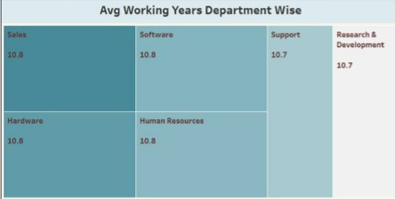
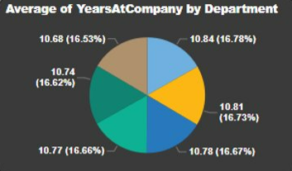
KPI 4: Average working years for each Department
Insights :
Here, values are shown as Average working years for each Department.
It is observed that Average working year of employees is highest in the Sales department 10.84 Years
Lowest Average working Year for Research and development Department is 10.68 years.

Slide 11
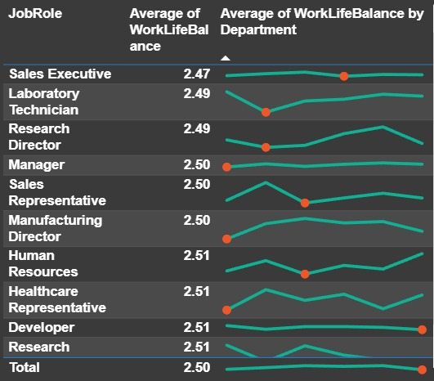
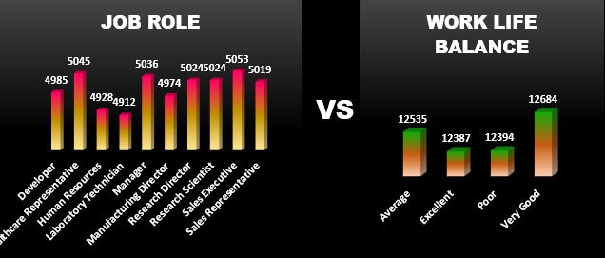
KPI 5: Job Role Vs Work life balance
Insights :
Sales executives have the lowest work-life balance rating and the highest attrition rate.
Research scientists have the highest work-life balance rating and the lowest attrition rate.
Healthcare representatives have a high work-life balance rating but a relatively high attrition rate.

Slide 12
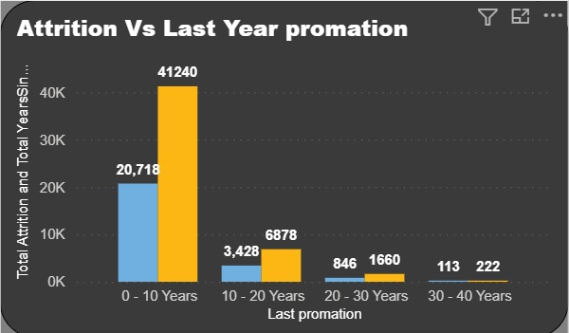
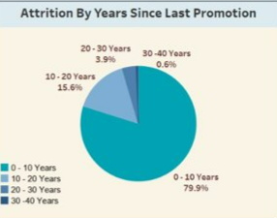
KPI 6: Attrition rate Vs Year since last promotion relation
Insights :
Employees in the 1-10 range of last year's promotion had a higher attrition rate.
Employees who received a promotion in the past year had a significantly higher attrition rate than those who did not.
Employees who received a promotion in the past year and had not yet reached a year since their last promotion had the lowest attrition rate.

Slide 13
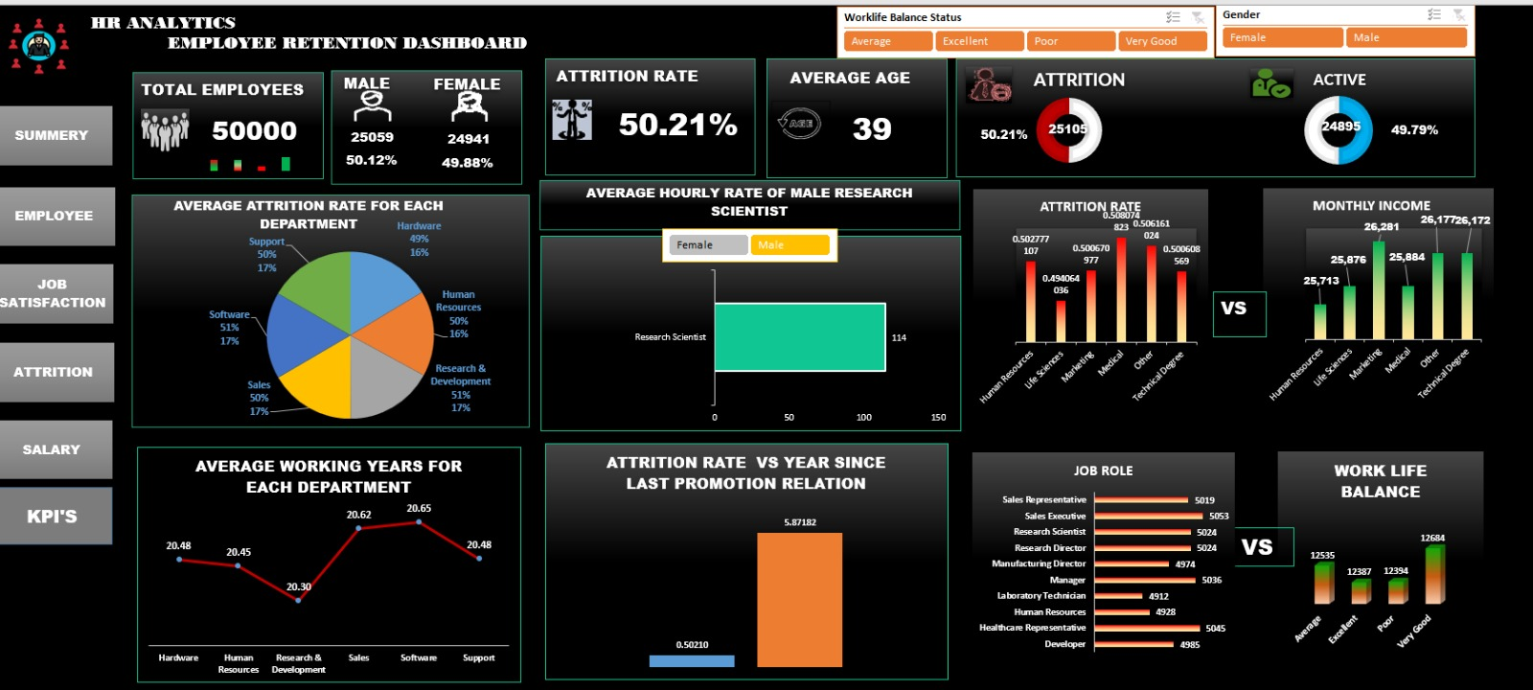
Dashboard in Excel

Slide 14
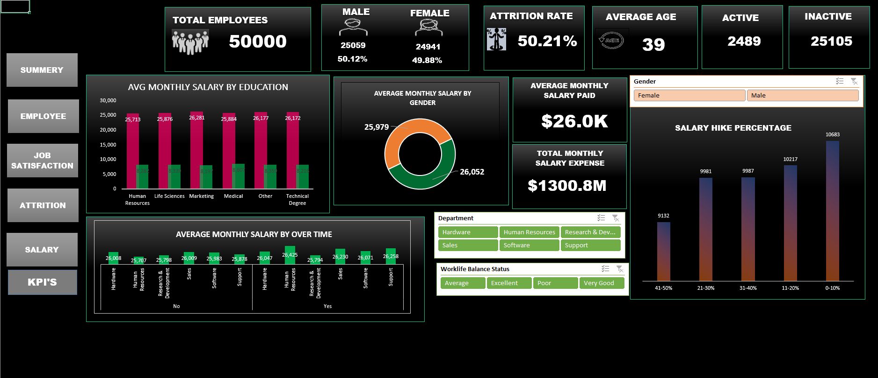
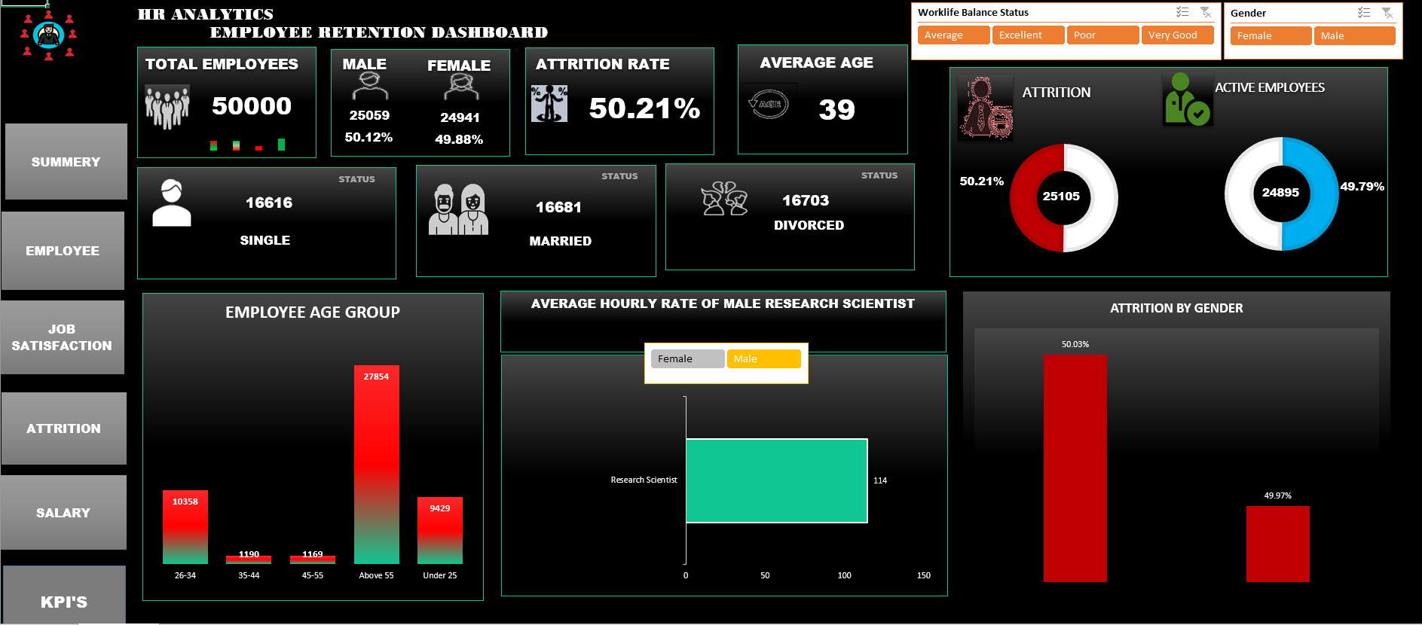
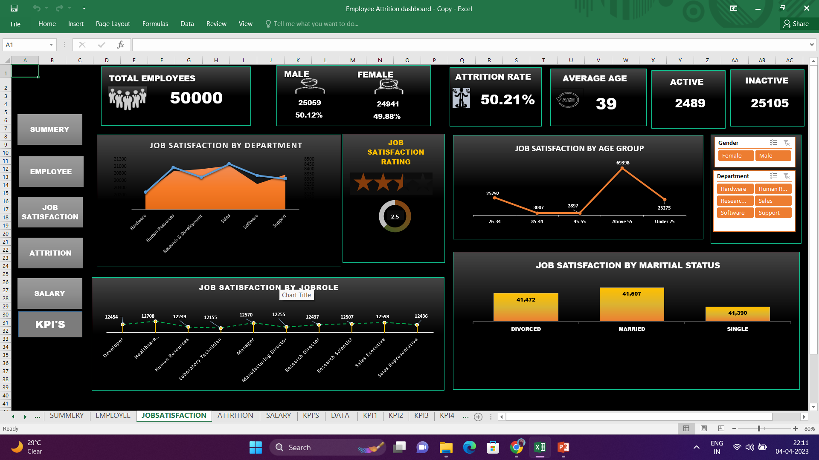
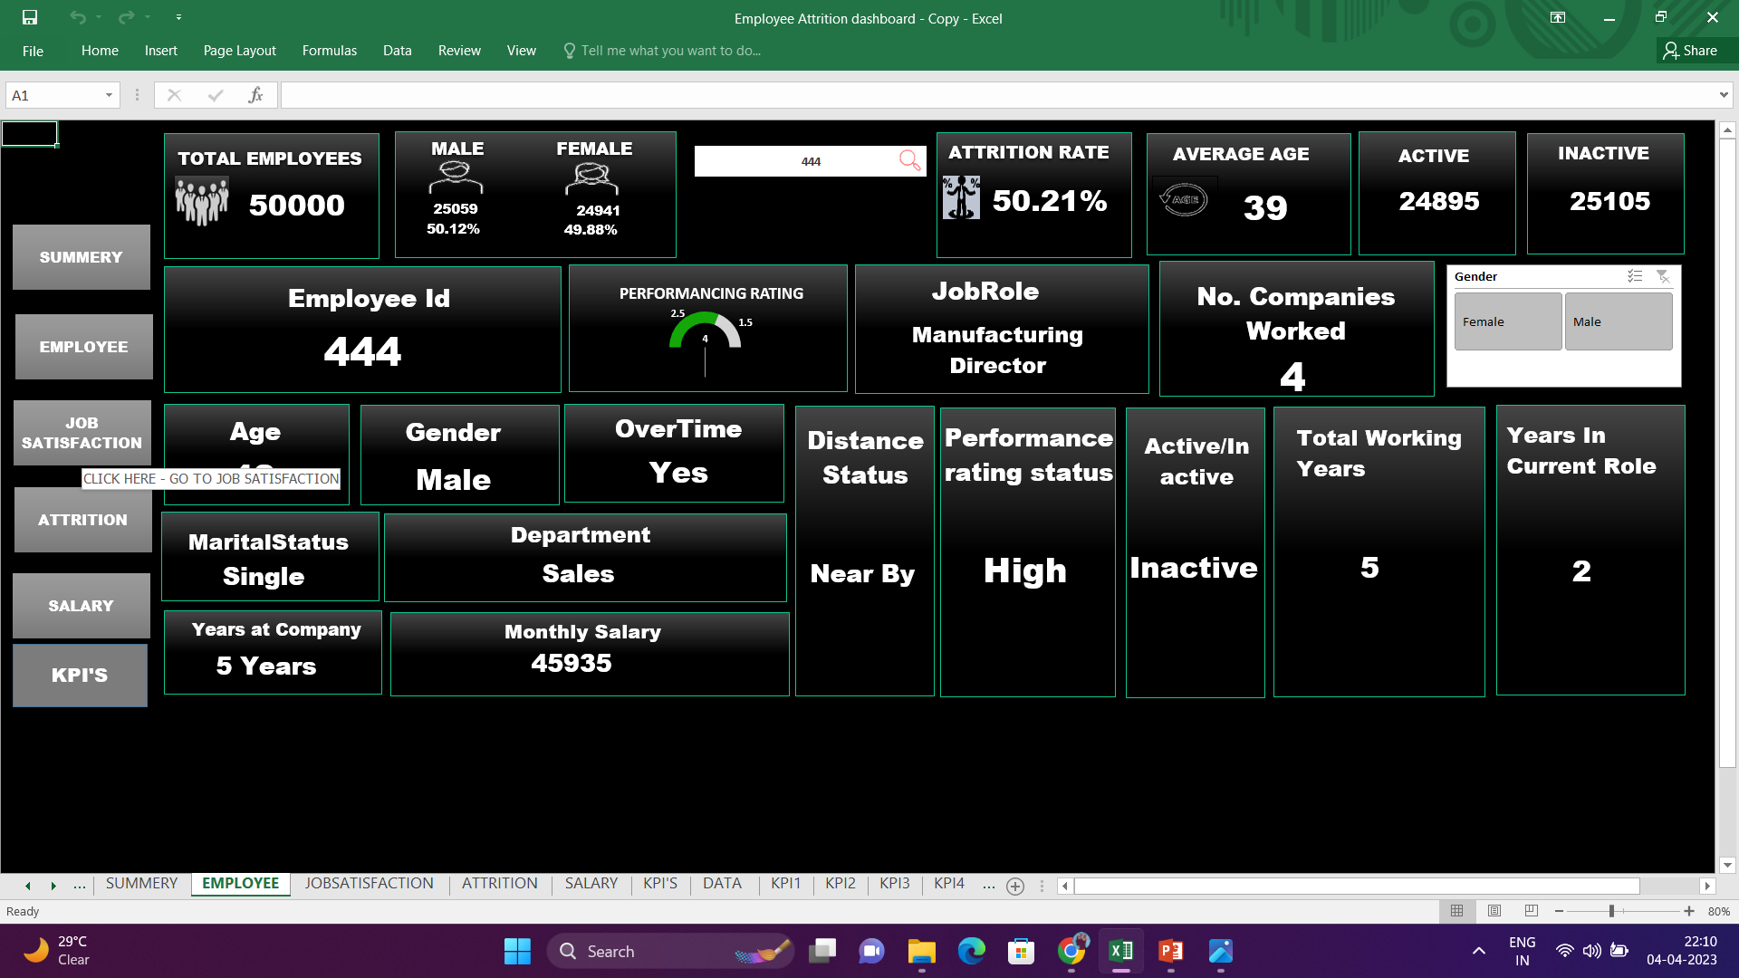
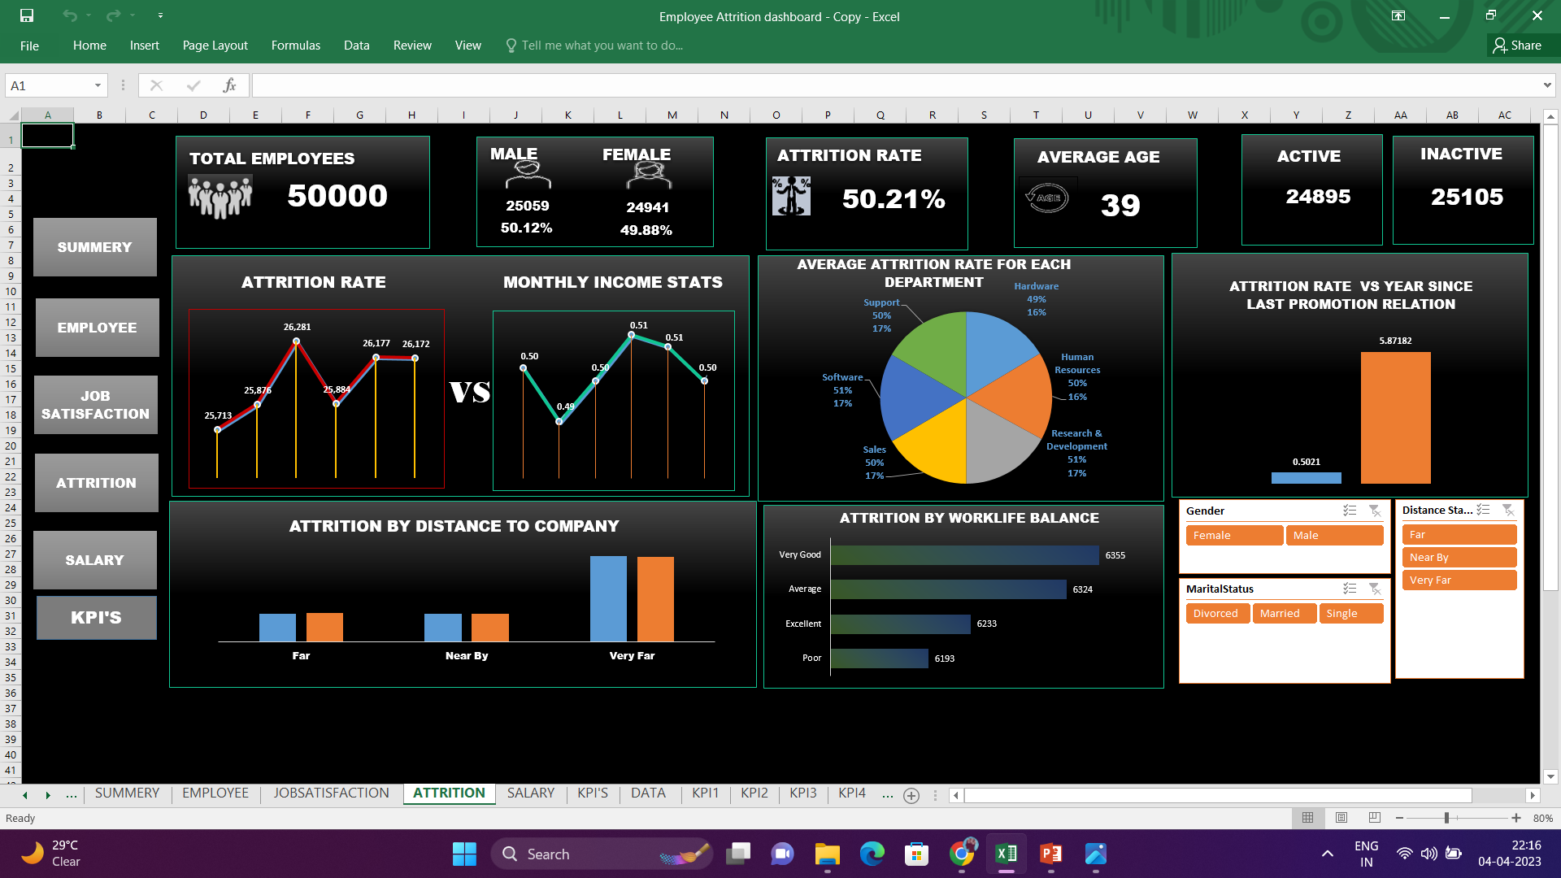

Slide 15
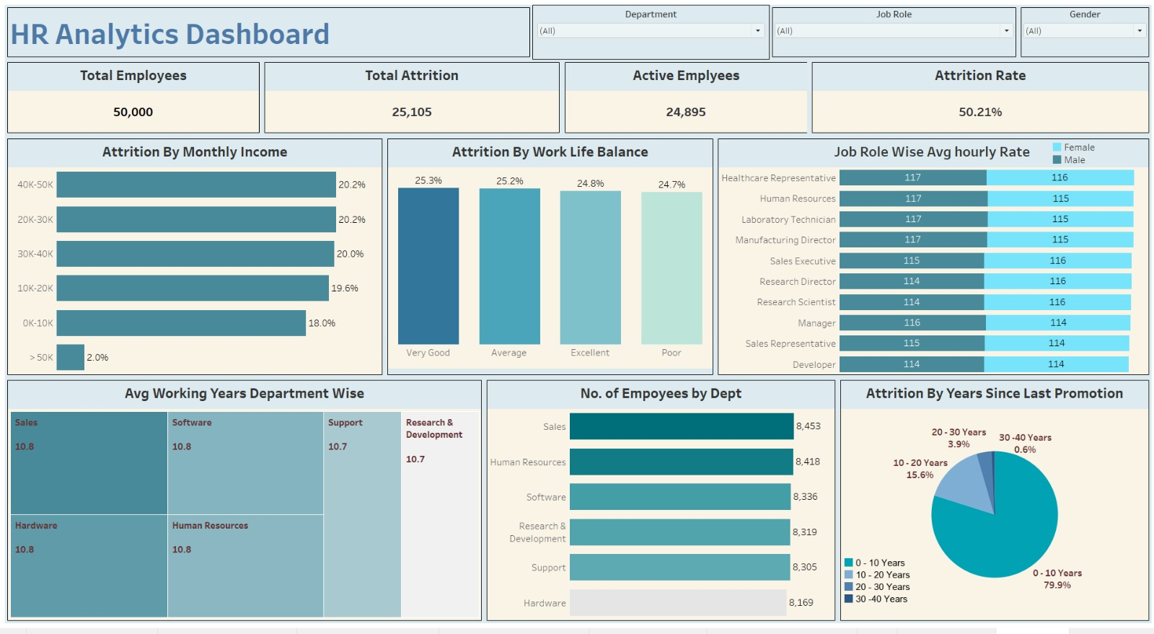
Dashboard in Tableau

Slide 16
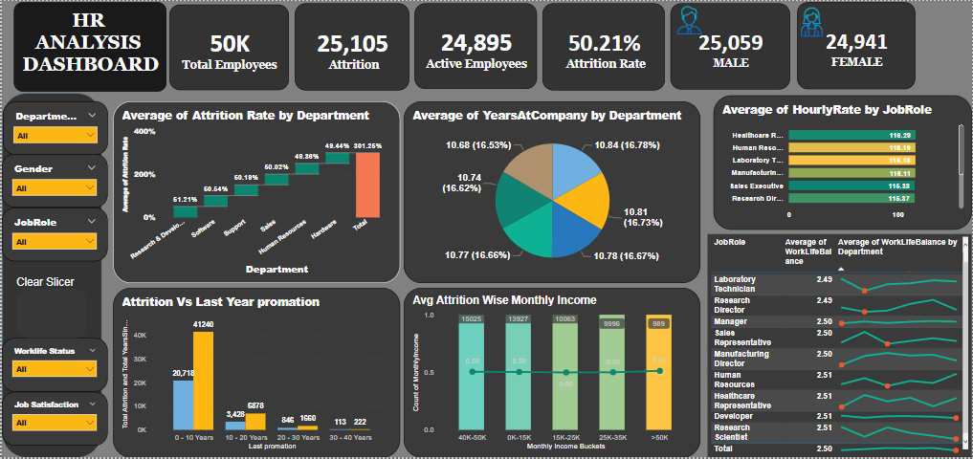
Dashboard in Power BI

Slide 17
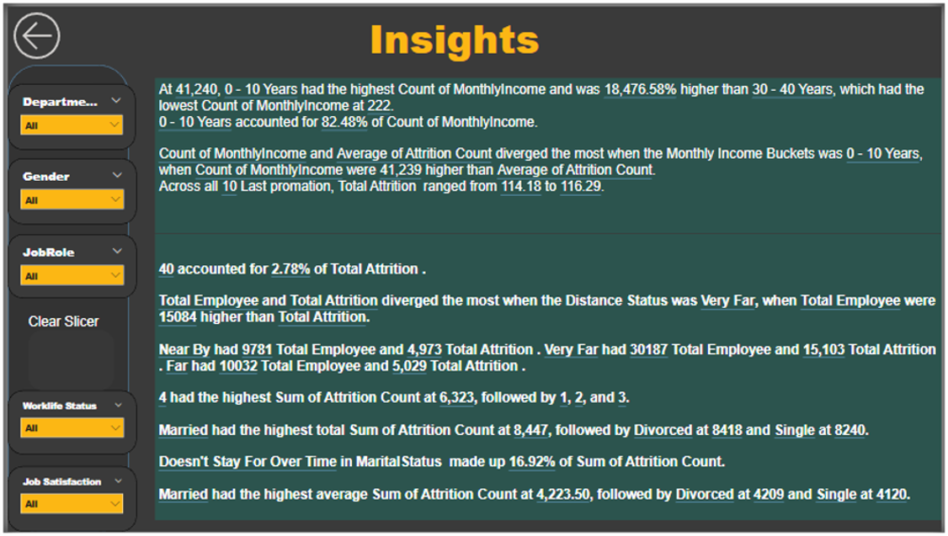
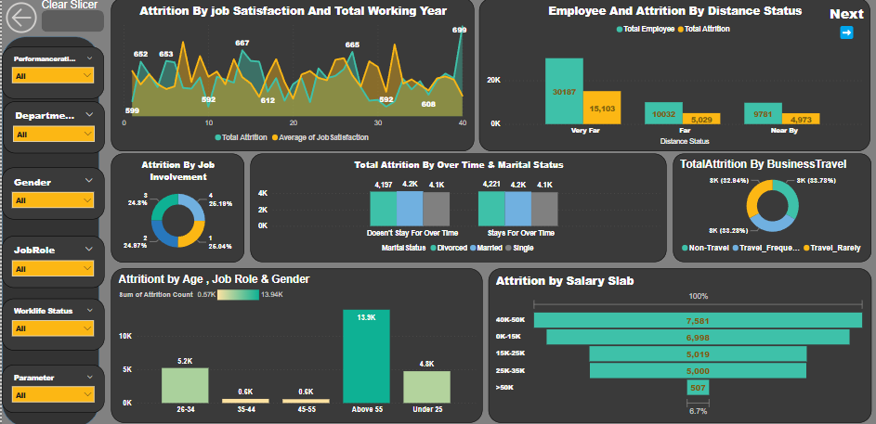

Slide 18

Overview And Major Findings
Now that we know the attributes of higher attrition employees, we can act on them by identifying at-risk employee groups to then consider corrective measures such as incentives (e.g. more competitive pay, overtime flexibility or reassign employees to different projects to improve engagement).
Looking at the list of factors, leadership may decide to invest more in employee education, employee promotion paths, or offer existing employees more opportunities switch to other internal opportunities to help them try out job roles that might suit their interests and skills sets better.

Slide 19


